Slide 1
Module 7: Establishing a Debt Policy
Revised March 2025

Slide 2
Using Debt
State and Local Government Finance Division
Debt is a tool that can be used to leverage available resources.
A mixture of debt and current resources may be used to finance projects.
Debt service must be included in the budget.^{[1]}

Slide 3
Debt Burden
State and Local Government Finance Division
Before issuing new debt, local governments should think about how it will affect their overall debt burden.
An unreasonable or heavy debt burden will limit future opportunities that a local government can take advantage of.

Slide 4
Debt Service Reminders
State and Local Government Finance Division
The LGC notifies local governments of debt service obligations for all debt approved by the LGC:
LGC 129s - Yearly notifications (sent by May 1) notifying units of total obligations for the coming fiscal year.^{[2]}
LGC 131s – Monthly notifications (sent at least 30 days before payment due dates) reminding units of upcoming principal and/or interest payments on outstanding obligations.^{[3]}
Payments must then be reported to the LGC on provided forms.^{[4]}
Questions or concerns related to these reminders should be directed to:
LGC129@nctreasurer.com (annual notifications)
LGC131@nctreasurer.com (monthly notifications)

Slide 5
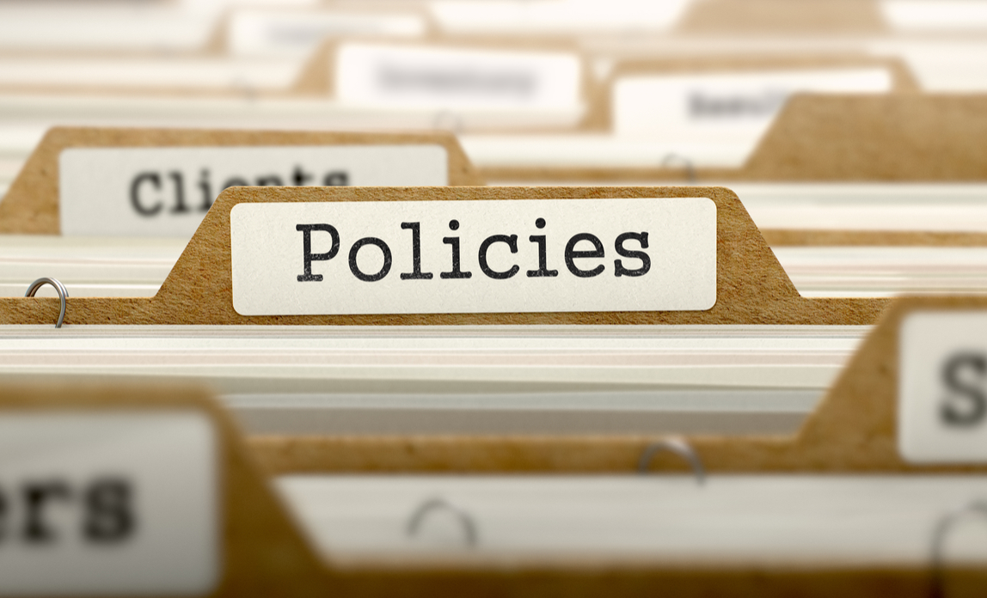
Establishing a Debt Policy
State and Local Government Finance Division
The governing board should establish a debt management policy.
A debt policy will help the government manage its finances and meet obligations.

Slide 6
Establishing a Debt Policy
State and Local Government Finance Division
A well written debt policy should include:
Uses of debt (When should debt be used?)
Types of debt permitted (What types of debt should be used in different situations?)
Debt limitation (How much debt should the unit take on?)
Debt repayment (When should debt be paid off and how should payments be structured over time?)
Refer to the sample debt policy on the LGC website as an example.

Slide 7
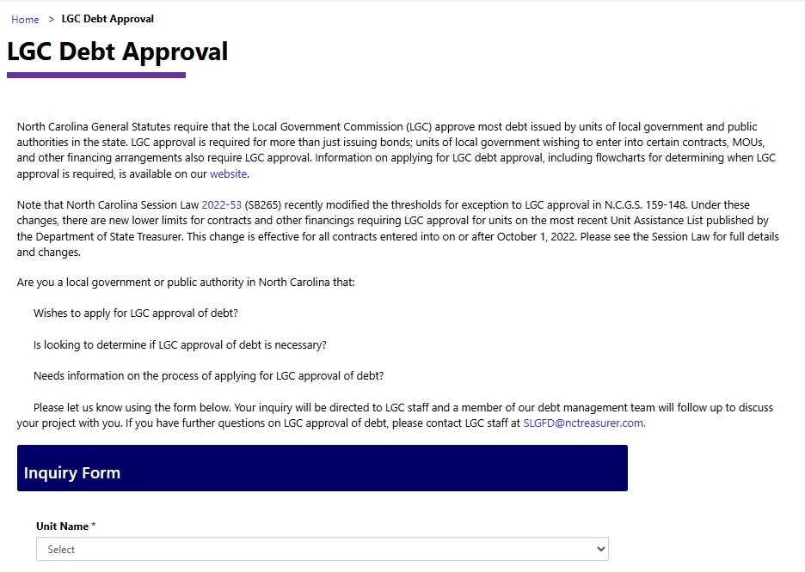
LGC Approval of Debt
State and Local Government Finance Division
Before issuing bonds^{[5]} or other types of debt^{[6]}, governing boards must submit a debt application to the LGC.
To determine whether LGC approval is required for a specific debt issuance:
Fill out a debt inquiry form with whatever information you can provide.
Consult the flow charts and other resources on the LGC website.
Reach out to LGC staff for guidance. We are happy to help determine if LGC approval is required.

Slide 8
LGC Approval of Debt
State and Local Government Finance Division
The LGC has adopted specific guidelines for the review and approval of debt applications.
Units with Financial Performance Indicators of Concern (FPICs) must submit any required FPIC responses before applying for debt.

Slide 9
Resources
State and Local Government Finance Division
Further reading:
LGC Approval of Bonds, Installment Financings, Leases, and Other Contracts Involving Capital Assets (UNC School of Government)
How Often Do Local General Obligation Bond Referenda Succeed in North Carolina? (UNC School of Government)
Debt Reports and Notices
Sample Debt Policy
Applying for Debt
Debt Inquiry Form
LGC Debt Approval Guidelines

Slide 10
Resources
State and Local Government Finance Division
UNC School of Government
NC Finance Connect
Finance Calendar of Duties
NC Local Government Finance 101
NC League of Municipalities
North Carolina Association of County Commissioners
Government Finance Officers Association - Best Practices & Resources
Contact LGC Staff: (919) 814-4300
Visit the LGC Website
Sign up for the LGC Staff Blog
Stay up to date with SLGFD Memos

Slide 11
Quiz: Module 7
State and Local Government Finance Division
What is a tool that can be used to leverage available resources?
Does debt service have to be included in the budget?
What is one thing a good debt policy should include?

