Slide 1
Module 2: Budgets
Revised March 2025

Slide 2
Budget Overview
State and Local Government Finance Division
The budget is the most important fiscal document a governing board produces.
Developing a budget is a fundamental responsibility of a governing board.
The budget reflects the priorities of the governing board.
The Local Government Budget and Fiscal Control Act (LGBFCA) provides requirements for the development and adoption of a budget, including key dates.^{[1]}

Slide 3
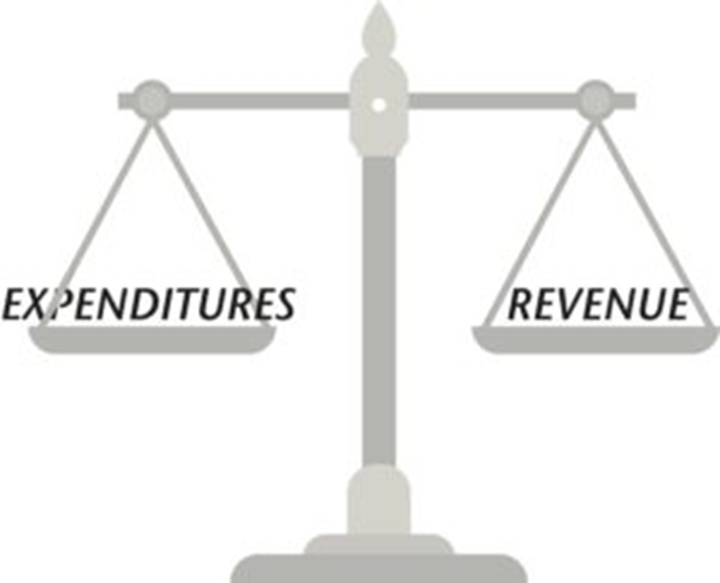
Budget Requirements
State and Local Government Finance Division
The budget for a local government must cover a period from July 1 to June 30.^{[2]}
This is the unit’s fiscal year.
The budget must be balanced.^{[3]}
Recurring revenues should equal recurring expenditures.
Fund balance should be reserved for special or unexpected circumstances.
It should not be used to fund recurring expenditures such as payroll or utilities.

Slide 4
Budget Requirements
State and Local Government Finance Division
With limited exceptions, local governments may not spend any money that is not accounted for in the annual budget.^{[4]}

Slide 5
Budget Officer
State and Local Government Finance Division
Every local government must have a budget officer.^{[5]}
For units operating under a manager form of government, the manager is the budget officer.
This includes all 100 North Carolina counties.
Municipalities not using the council-manager form of government may impose the duty of budget officer on any officer or employee, including the mayor.
The budget officer has two main duties:
Prepare the annual budget
Execute the annual budget

Slide 6
Governing Board Responsibilities
State and Local Government Finance Division
The governing board plays a key role in the budget preparation process by:
Establishing a solid timeline that allows the unit to consistently meet deadlines laid out in the LGBFCA.
Providing guidance, priorities, and goals to the budget officer.
For example, a board may wish to allocate funds for staff raises, implement a new tax rate, etc.

Slide 7
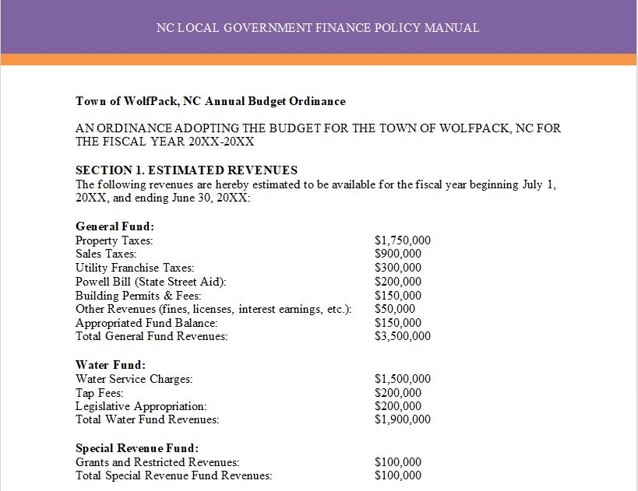
Budget Ordinance
State and Local Government Finance Division
The budget ordinance is the legal document that:^{[6]}
Estimates operating revenues.
Establishes authority to spend public monies via appropriations.
Levies ad valorem taxes.
A budget ordinance should also include provisions for staff such as authority to transfer appropriations within a fund up to a certain limit.

Slide 8
Budget Ordinance
State and Local Government Finance Division
The budget ordinance must levy taxes “at rates that will produce the revenue necessary to balance appropriations and revenues.”^{[7]}
Therefore, the budget ordinance should include:
Tax rate
Valuation of taxable property
Expected collection percentage
Units may not assume a higher tax collection percentage than what was actually realized during the last fiscal year.^{[8]}
“In other words, the budget may not be overly optimistic about how much of next year’s tax levy will result in actual dollars in the bank.”^{[9]}

Slide 9
Budget Adoption Timeline
State and Local Government Finance Division
January – April
The unit should hold budget workshops to discuss goals and priorities for the next budget.
The budget officer should estimate revenues and expenditures for the current and upcoming fiscal years.
Before April 30*
Department heads must submit budget requests and estimated revenues for their departments.^{[10]}
*Or earlier if required by the budget officer
By June 1
The budget officer must submit the proposed budget and budget message to the governing board.^{[11]}
Ideally, this submission should be part of a public meeting.
Upon submission
The budget officer must file the proposed budget with the board’s clerk on the same day it is submitted to the board.^{[12]}
The clerk must then make the budget available to the media/public and schedule a public hearing.
Before the budget is approved
The board must hold a public hearing at which those who wish to comment on the budget are allowed to speak.^{[13]}
By July 1
The board must adopt a budget ordinance.^{[14]}
At least 10 days must pass between submission of the budget to the governing board and adoption of the budget ordinance.
Within five days of adoption
Copies of the budget ordinance must be filed with the finance officer, budget officer and board’s clerk.^{[15]}

Slide 10
Interim Budget
State and Local Government Finance Division
If the budget ordinance cannot be adopted by July 1, an interim budget ordinance must be adopted.^{[16]}
Disbursements cannot be made after June 30 without an annual budget ordinance or interim budget ordinance.
Property taxes are not levied in an interim budget ordinance.
Interim budgets should be used rarely and for the shortest possible time.
When the final budget is adopted, the expenditures incurred under the interim budget must be included in the final budget.

Slide 11
Budget Amendments
State and Local Government Finance Division
The budget can be amended by the governing board at any time, as long as it remains balanced and continues to meet all other statutory requirements.^{[17]}
A budget amendment is adopted at a regular meeting and does not require a public hearing.
Budget amendments must be made prior to obligating funds in excess of budgeted appropriations.
An amendment to the budget ordinance may not alter the tax levy unless:
The board is directed to do so by a court or authorized state agency.
OR
Revenues received are substantially more or less than the amount estimated in budget. (In this case, the amendment may only be adopted before January 1.)

Slide 12
Fund Balance Available
State and Local Government Finance Division
Fund Balance Available or FBA is a governmental accounting term used only in North Carolina.
It is the portion of a unit’s total fund balance that can legally be used, if needed, to balance the annual budget.
FBA can be calculated from a unit’s annual audit using this spreadsheet provided by LGC staff.
Governments should develop a fund balance policy and adhere to it when taking budget actions.
Sample fund balance policies are available from NC Finance Connect.
Following a well-established fund balance policy can help units ensure that sufficient funds are available for special or unexpected circumstances.

Slide 13
FBA Targets
State and Local Government Finance Division
While there is no mandated minimum fund balance for units, the LGC uses established FBA thresholds as a measure of a unit’s financial health.
To learn more about the LGC’s FBA recommendations and determine a target that is appropriate for your unit, start by reading this blog post.
Annual reports on Management of Cash and Taxes and Fund Balance Available are available on the LGC website.

Slide 14
Creating Capital Reserves
State and Local Government Finance Division
The resolution or ordinance establishing the capital reserve fund must include:^{[18]}
The purposes for which the fund is created.
The approximate period of time during which the moneys are to be accumulated for each purpose.
The approximate amounts to be accumulated for each purpose.
The sources from which moneys for each purpose will be derived.
To save money for capital projects, such as new buildings or infrastructure improvements, governing boards can and should establish a capital reserve fund.

Slide 15
Using Capital Reserves
State and Local Government Finance Division
To make a withdrawal from a capital reserve fund, the governing board must pass a separate resolution or ordinance authorizing the specific withdrawal.^{[19]}
Withdrawals may only be authorized for purposes specified in the original resolution/ordinance establishing the fund or a purpose added in a subsequent amendment.

Slide 16
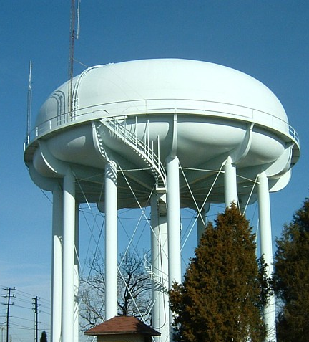
Other Considerations
State and Local Government Finance Division
Before transferring excess revenues from an enterprise fund to another fund, governing boards should:
Understand the statutory limitations^{[20]} and potential consequences of such transfers.
Carefully consider whether the specific transfer is in the best interest of the unit.
Read this blog post for an in-depth discussion of this topic.

Slide 17
Other Considerations
State and Local Government Finance Division
For Example:
If the offices for a utility enterprise take up 20% of the square footage in city hall, then 20% of the upkeep expenses for city hall may be allocated to the enterprise fund.
If an operating expense serves/benefits multiple funds, it may be posted across those funds, using a reasonable allocation basis such as square footage.

Slide 18
Other Considerations
State and Local Government Finance Division
When developing a budget, governing boards should always try to think long-term.
Current budgeting priorities may impact the government for years to come.

Slide 19
Resources
State and Local Government Finance Division
Introduction to Local Government Budgeting (UNC School of Government)
N.C. Local Government Finance Policy Manual, Chapter 2: Budgeting (UNC School of Government)
N.C. Local Government Finance Policy Manual, Chapter 3: Fund Balance (UNC School of Government)
Sample Budget Ordinances (UNC School of Government)
Sample Adopted Budget (UNC School of Government)
Sample Budget Amendment
Fund Balance Available calculation
Sample Fund Balance Policies (UNC School of Government)

Slide 20
Resources
State and Local Government Finance Division
UNC School of Government
NC Finance Connect
Finance Calendar of Duties
NC Local Government Finance 101
NC League of Municipalities
North Carolina Association of County Commissioners
Government Finance Officers Association - Best Practices & Resources
Contact LGC Staff: (919) 814-4300
Visit the LGC Website
Sign up for the LGC Staff Blog
Stay up to date with SLGFD Memos

Slide 21
Quiz: Module 2
State and Local Government Finance Division
What is the most important fiscal document a governing board produces?
Who is responsible for preparing and executing the annual budget?
By what date must the budget ordinance be adopted by the governing board?

