Slide 1
Module 1: Responsibilities of Board Members & Introduction to Local Government Commission
Revised March 2025

Slide 2
Responsibilities of Board Members
State and Local Government Finance Division
Members of a governing board have a fiduciary responsibility to the unit’s taxpayers and residents to manage funds and the unit appropriately.
The governing board is ultimately responsible for the finances and fiscal health of the unit.

Slide 3
Responsibilities of Board Members
State and Local Government Finance Division
Local governing boards are granted specific financial authorities and responsibilities in North Carolina General Statute 159, Article 3:
The Local Government Budget and Fiscal Control Act (LGBFCA). ^{[1]}

Slide 4
The Local Government Budget and Fiscal Control Act
State and Local Government Finance Division
The LGBFCA sets forth requirements for local governments in areas such as:
Budgets
Fiscal control
Borrowing money
Members of governing boards should develop a strong working knowledge of the LGBFCA.
The act is just 35 pages and is available to read at ncleg.gov.
Key sections are covered in this training.

Slide 5
The Local Government Budget and Fiscal Control Act
State and Local Government Finance Division
Governing boards play a crucial role in overseeing a unit’s compliance with the LGBFCA.
Board members set expectations for employees to follow requirements of the LGBFCA.

Slide 6
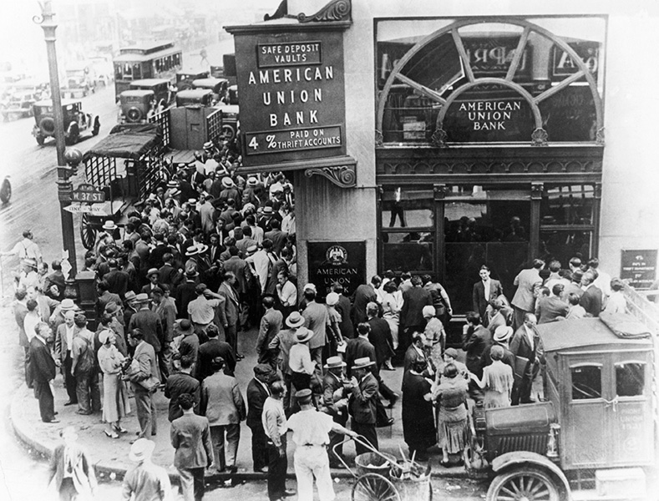
Local Government Commission (LGC)
State and Local Government Finance Division
Established in 1931 to address fiscal challenges faced by local governments during the Great Depression, the Local Government Commission (LGC)^{[2]} continues to provide financial oversight for more than 1,100 units of local government across the state, including 550+ municipalities and all 100 counties.

Slide 7
LGC Impact
State and Local Government Finance Division
“When state and local officials talk about best practices in financial oversight, they often point to North Carolina.”
The Pew Charitable Trusts, “State Strategies to Detect Local Fiscal Distress” (2016)
90+ years of LGC oversight has led to:
Above-average debt ratings for local governments.
“AAA” credit rating for the state from all three ratings agencies.
Lower cost of borrowing for North Carolina taxpayers.
Confidence in North Carolina’s debt market and the fiscal health of its local governments.

Slide 8
LGC Members
State and Local Government Finance Division
The LGC is composed of nine members.
State Treasurer, Brad Briner, serves as Chair.
Other members include the State Auditor, Secretary of Revenue, Secretary of State, and five appointed members.

Slide 9
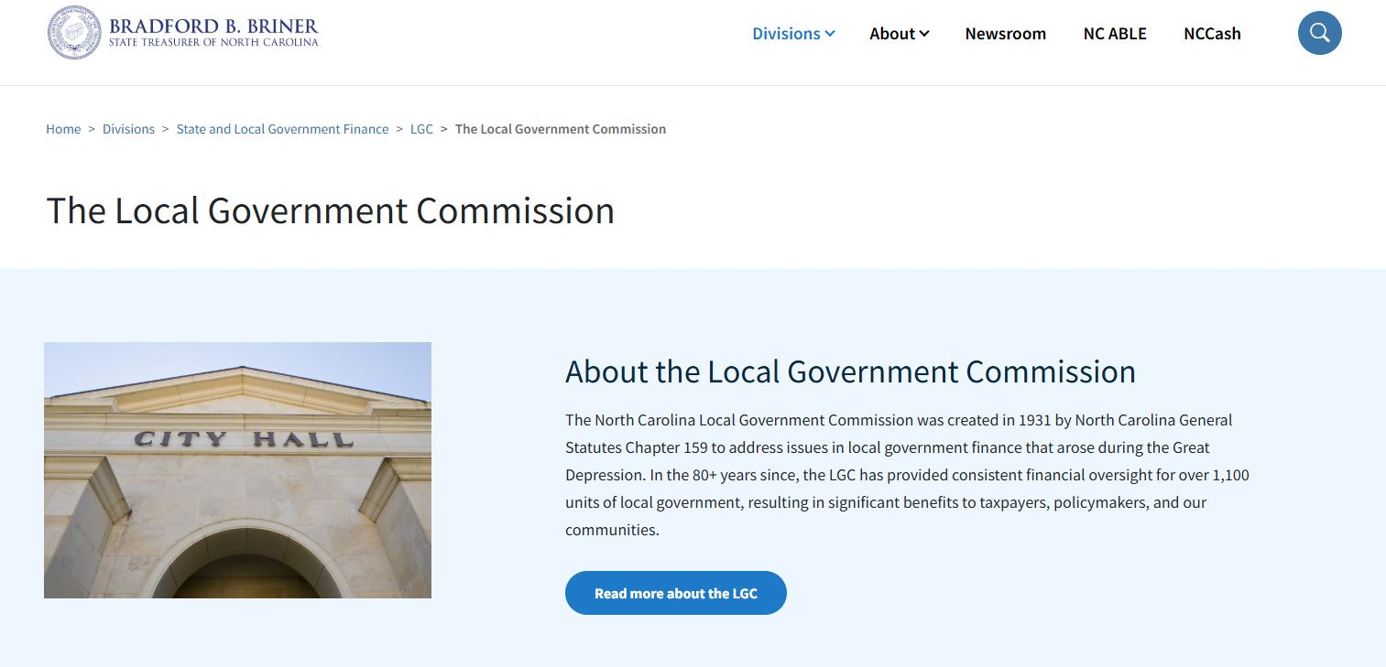
LGC Meetings
State and Local Government Finance Division
LGC meetings are held the first Tuesday of each month at 1:30 p.m.
Meetings can be live streamed from the LGC page on the Department of State Treasurer website.
The LGC page also contains links to meeting agendas and recordings of past meetings.

Slide 10
LGC Staff
State and Local Government Finance Division
LGC staff provide:
Expert assistance to units as needed.
In-person and virtual education/training for local officials.
Up-to-date guidance on local government finance via memos and blog posts.
Helpful information and resources on the LGC website.
The LGC is staffed by employees of the State and Local Government Finance Division (SLGFD) within the Department of State Treasurer (DST).
LGC staff work hard to assist the LGC and units of local government across the state.

Slide 11
Reporting Requirements and Due Dates for Local Governments
State and Local Government Finance Division
Units are required by law to regularly submit certain financial information to the LGC. This includes, but is not limited to:
Annual Audit^{[3]} – Due Dec. 31 for units with a June 30 fiscal year end
Annual Financial Information Report (AFIR)^{[4]} – Due Dec. 31
Semi-Annual Cash and Investment Report (LGC-203)^{[5]} – Due Jan. 25 and July 25
Register of Deeds Fees Report (Counties)^{[6]} – Due on the 10th of each month
Visit the LGC Reporting Requirements and Due Dates page for more information on these and other reporting deadlines.

Slide 12
Key Areas of LGC Authority for Local Governments
State and Local Government Finance Division
The Local Government Commission has authority under certain circumstances:
To require the finance officer or anyone performing the duties of the finance officer to participate in training.^{[7]}
To require local governments and public authorities to contract with outside entities, such as a third-party bookkeeper, to fulfill the duties of finance officer.^{[8]}
To impound the books and records of a local government and assume full control of all its financial affairs.^{[9]}

Slide 13
Resources
State and Local Government Finance Division
UNC School of Government
NC Finance Connect
Finance Calendar of Duties
NC Local Government Finance 101
NC League of Municipalities
North Carolina Association of County Commissioners
Government Finance Officers Association - Best Practices & Resources
Contact LGC Staff: (919) 814-4300
Visit the LGC Website
Sign up for the LGC Staff Blog
Stay up to date with SLGFD Memos

Slide 14
Quiz: Module 1
State and Local Government Finance Division
Who is ultimately responsible for the finances and fiscal health of a unit?
Who is the Chair of the Local Government Commission?
Does the Local Government Commission have the authority to impound the books and records and assume full control of all financial affairs of a unit?

